Slide 1
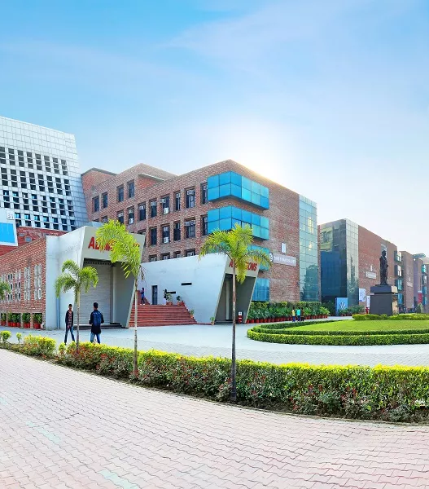
CAPSTONE SUPERVISOR ALLOCATION PORTAL FOR LPU STUDENTS
INT 213
PYTHON PROJECT
RAVI SINGH 11808322
PRATIK 11808492
KAMIDI SAI KRISHNA 11808447

Slide 2
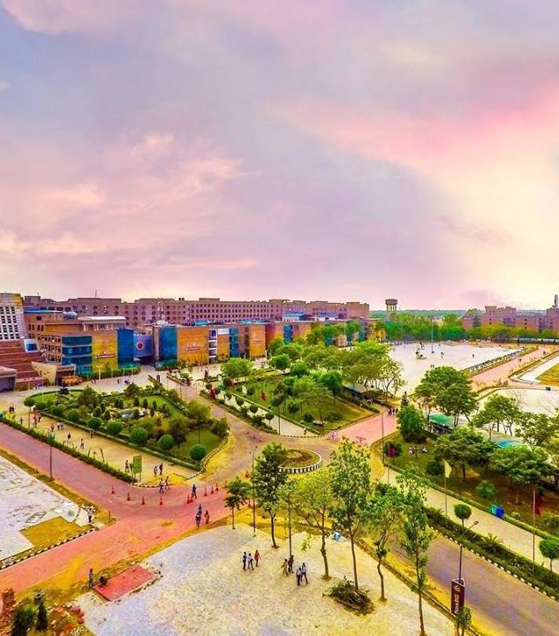
INTRODUCTION
In this project an attempt will be made to make a capstone supervisor allocation for LPU students using graphical user interface and a combination of basic concepts of Python i.e. - Dictionary, GUI, List etc.
A capstone project is a multifaceted assignment that serves as a culminating academic and intellectual experience for students, typically during their final year of high school or middle school, or at the end of an academic program or learning pathway experience. While similar in some ways to a college thesis, capstone projects may take a wide variety of forms, but most are long-term investigative projects that culminate in a final product, presentation, or performance. For example, students may be asked to select a topic, profession, or social problem that interests them, conduct research on the subject, maintain a portfolio of findings or results, create a final product demonstrating their learning acquisition or conclusions (a paper, short film, or multimedia presentation, for example), and give an oral presentation on the project to a panel of teachers, experts, and community members who collectively evaluate its quality.

Slide 3
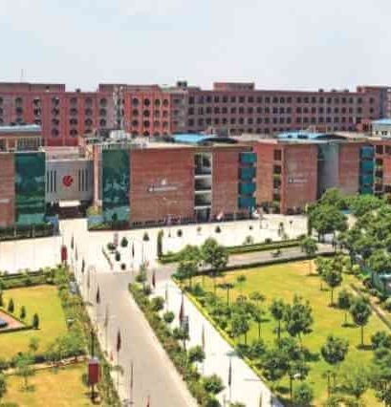
OBJECTIVE
The main objective of this project is to provide the hand free access to the portal through tkinter interface. This project of “CAPSTONE SUPERVISOR ALLOCATION FOR LPU STUDENT” gives us the complete information about the students and project they have opted for. We can enter the record of new student and retrieve the details of any project available in the database. We can issue the project to the students and maintain their records and can also check how many projects are issued and how many are available in the database. In this project we can maintain the record of students who has completed the project and their submission i.e. submission is before the due date or not. Throughout the project the focus has been on making the students to grab the project of which they are in need. The project is very useful for those who want to know about online Capstone project allocation System.

Slide 4
The prime objective of Capstone Supervisor allocation Portal for LPU students is to make in such way user can easily register or login easily.
For making this project I use GUI Programming in Python.
For making page interactive I use Canvas, Entry widget, photo Image, Label, Button etc
In that project we made 5 different pages using gui in first page there is 4 different option in which user can do his work like login, new user, request for supervisor, all page is connected user can go any page easily.
For saving user allocation data I use different technique.
Capstone projects are generally designed to encourage students to think critically, solve challenging problems, and develop skills such as oral communication, public speaking, research skills, media literacy, teamwork, planning, self-sufficiency, or goal setting—i.e., skills that will help prepare them for college, modern careers, and adult life.
In most cases, the projects are also interdisciplinary, in the sense that they require students to apply skills or investigate issues across many different subject areas or domains of knowledge. Capstone projects also tend to encourage students to connect their projects to community issues or problems, and to integrate outside-of-school learning experiences, including activities such as interviews, scientific observations, or internships.

Slide 5
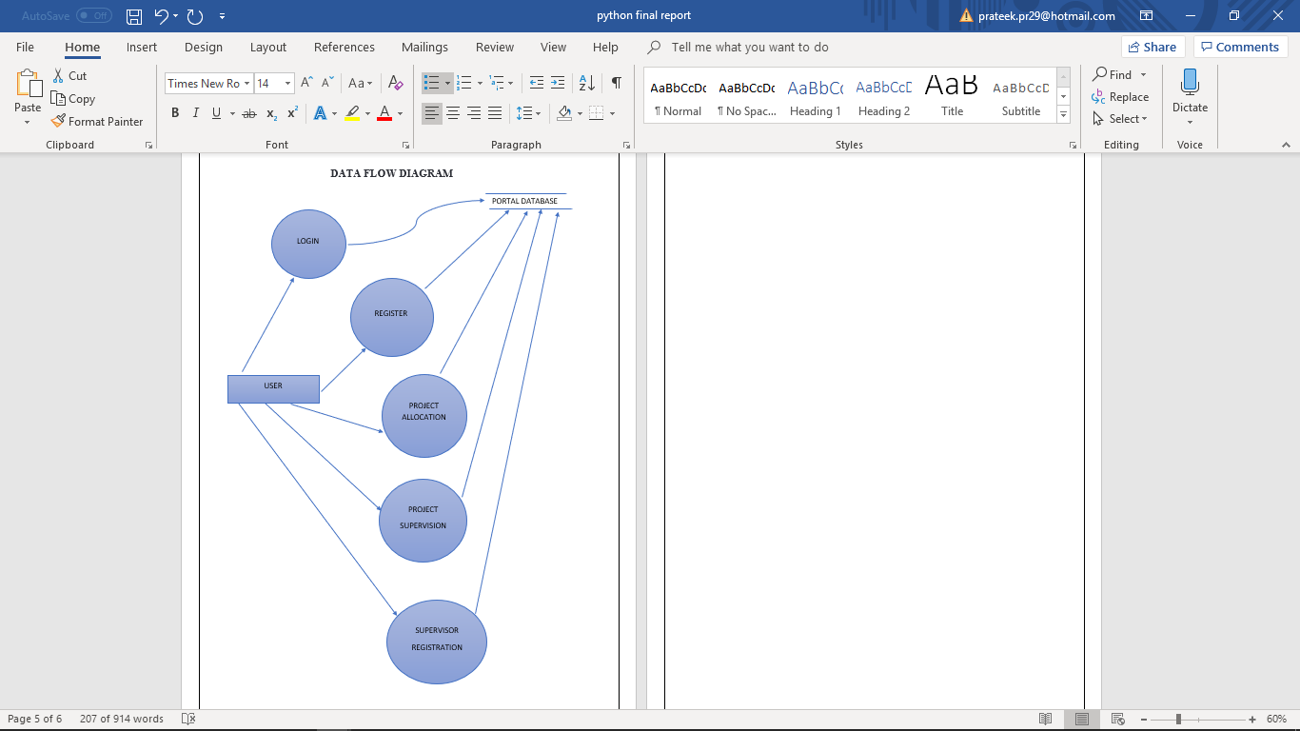
DATA FLOW DIAGRAM

Slide 6
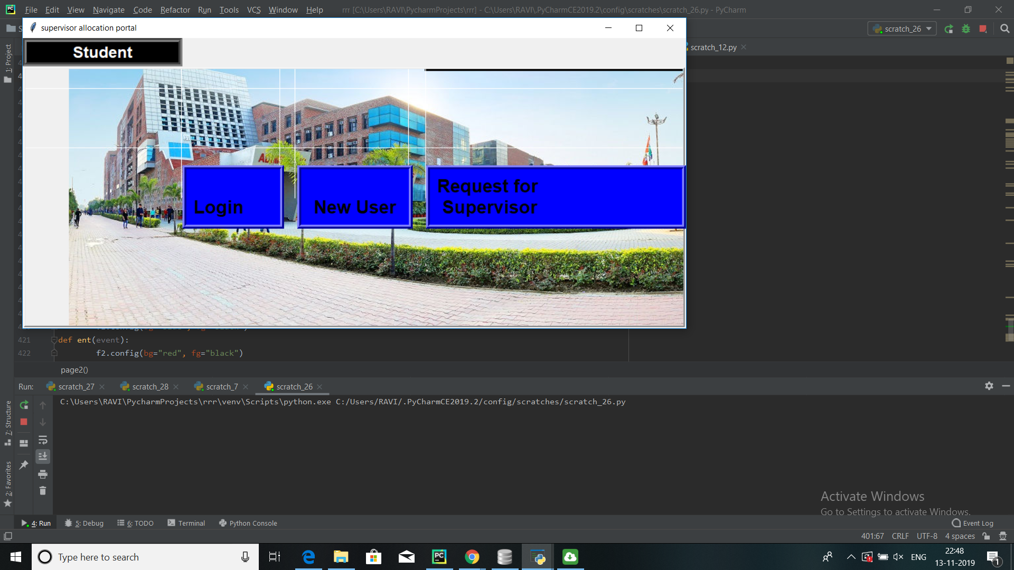
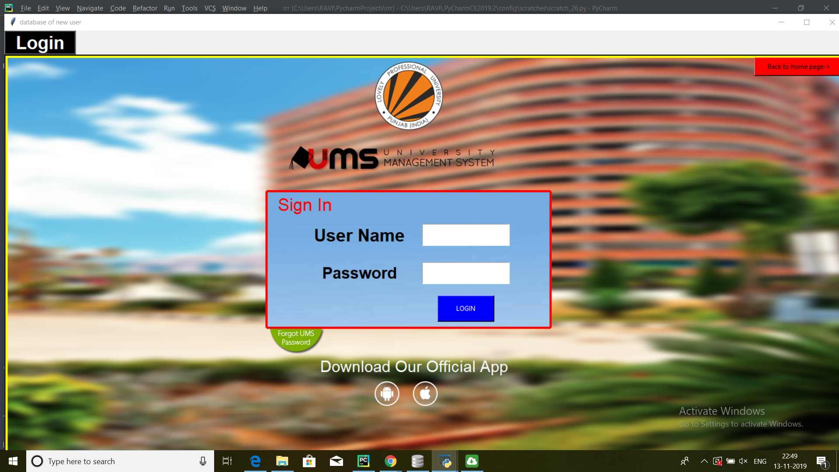
SCREEN SHOTS

Slide 7
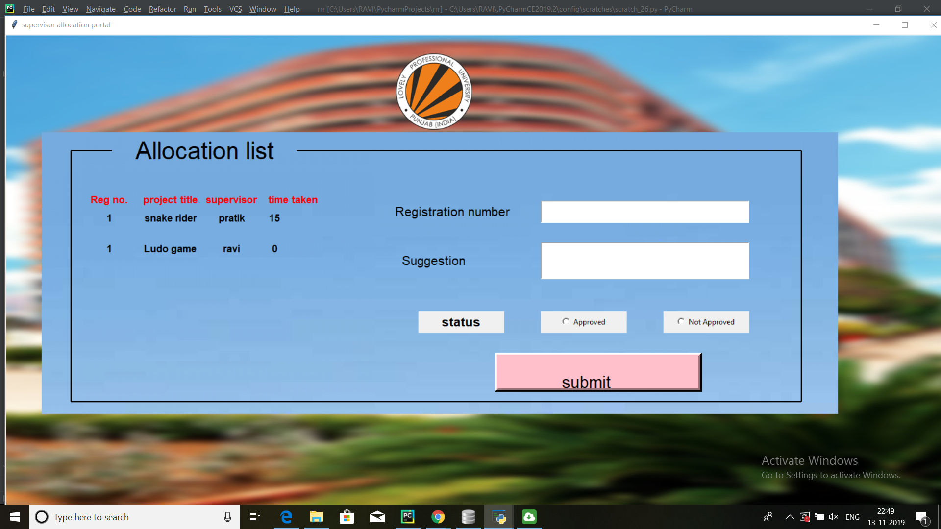
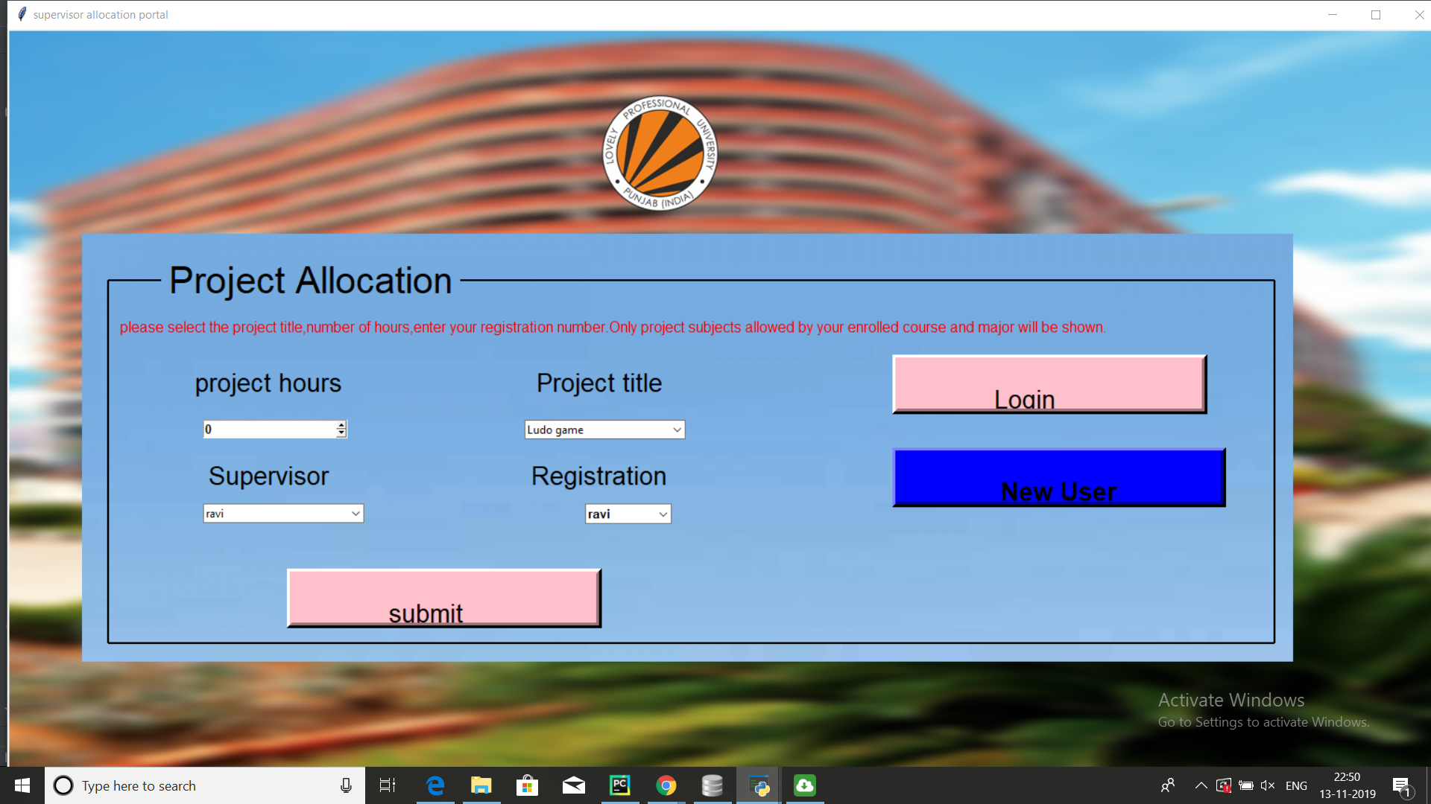

Slide 8
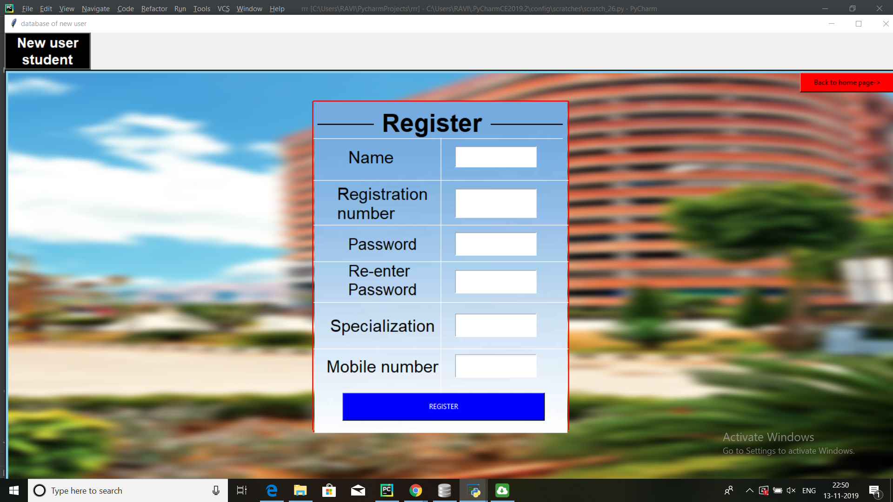
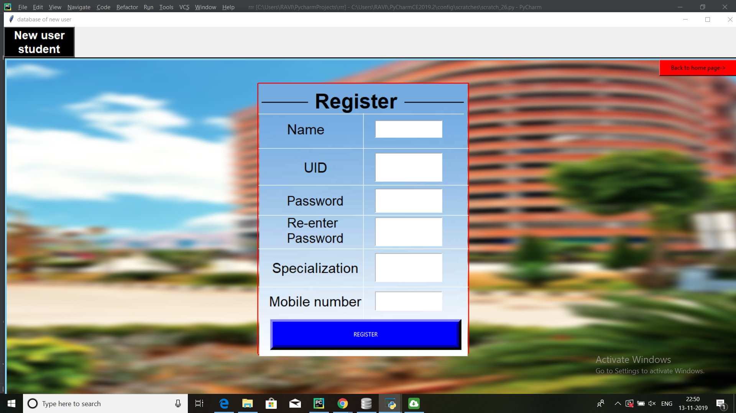

Slide 9
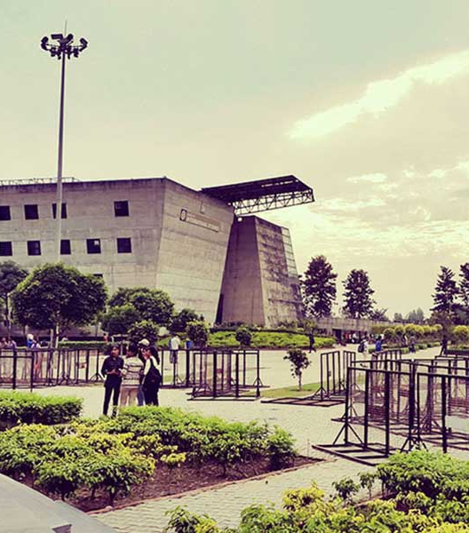
FUTURE SCOPE
Capstone projects can take a wide variety of forms from school to school, a few examples will help to illustrate both the concept and the general educational intentions in future:
Writing, directing, and filming a public-service announcement that will be aired on public-access television
Designing and building a product, computer program, app, or robot to address a specific need, such as assisting the disabled
Interning at a non-profit organization or a legislator’s office to learn more about strategies and policies intended to address social problems, such as poverty, hunger, or homelessness
Conducting a scientific study over several months or a year to determine the ecological or environmental impact of changes to a local habitat
Researching an industry or market, and creating a viable business plan for a proposed company that is then “pitched” to a panel of local business leaders

Slide 10
Increasing the academic rigor of the senior year. Historically, high school students have taken a lighter course load or left school early during their twelfth-grade year, which can contribute to learning loss or insufficient preparation for first-year college work. A more academically and intellectually challenging senior year, filled with demanding but stimulating learning experiences such as a capstone project, the reasoning goes, can reduce senior-year learning loss, keep students in school longer (or otherwise engaged in learning), and increase preparation for college and work.
Increasing educational and career aspirations. By involving students in long-term projects that intersect with personal interests and professional aspirations, capstone projects can help students with future planning, goal setting, postsecondary decisions, and career exploration—particularly for those students who may be unfocused, uncertain, or indecisive about their post-graduation plans and aspirations.
Demonstrating learning and proficiency. As one of many educational strategies broadly known as demonstrating of learning, capstone projects can be used to determine student proficiency (in the acquisition of knowledge and skills) or readiness (for college and work) by requiring them to demonstrate what they have learned over the course of their project

